Slide 1
FOOTBALL TRANSFER MARKET ANALYSIS
PRESENTED BY: SAILESH KUMAR M
LAST UPDATED: 20-May-24

Slide 2
The 2 main parameters in this project are
Market value - This is the base cost of a player. A player typically won’t be sold below this value.
Transfer value – This is the cost at which a player is sold.

Slide 3
Objectives:
To determine the overall market and transfer values in 5 Leagues.
To determine overall market and transfer values based on players playing positions.
To determine the overall market and transfer values among Premier League clubs.
To determine the maximum and minimum intake and release of players among Premier League clubs.

Slide 4
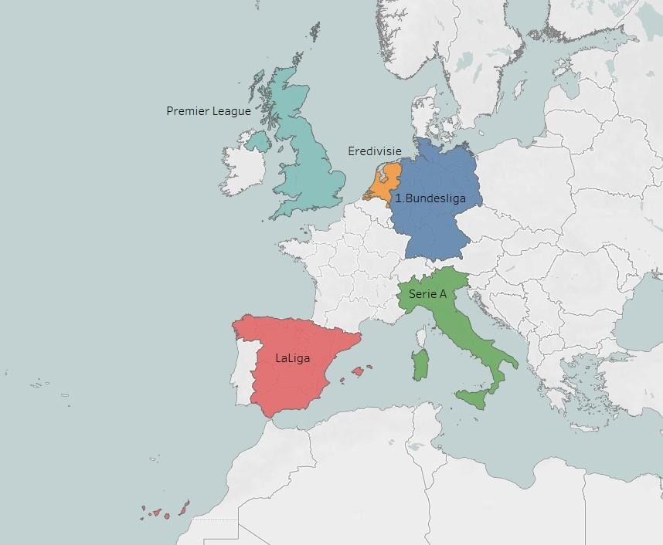
Location of the leagues
5 different league datasets have been taken from the 2010-2019 seasons for this project.
Premier League
La Liga
Bundesliga
Serie A
Eredivisie

Slide 5
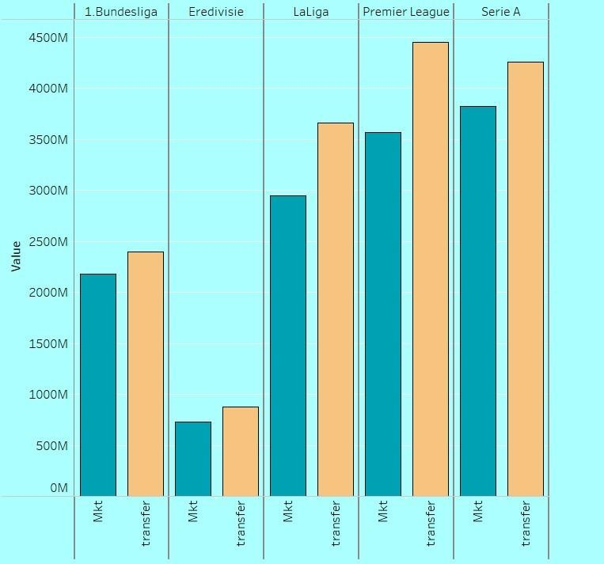
Market and transfer values based on leagues
The highest transfer value is for the Premier league whereas the lowest is for Eredivisie.

Slide 6
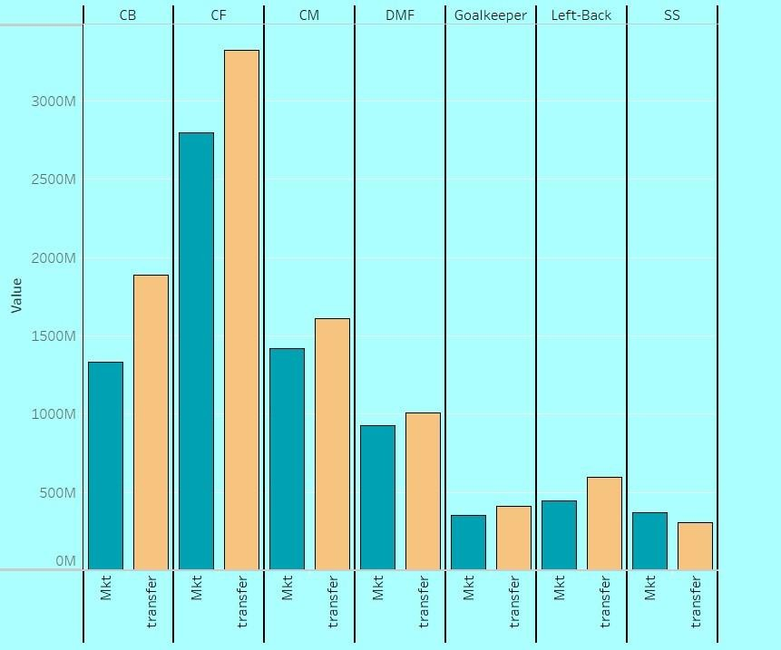
Market and transfer values based on position
Transfer values of the Center Forward(CF) position are the highest whereas Second Striker(SS) has the lowest transfer value.
The CF is the most in-demand position in the market.

Slide 7

Leeds has the lowest Market value among these clubs.
Market value plot of Premier League clubs
Chelsea has the highest Market value among these clubs

Slide 8
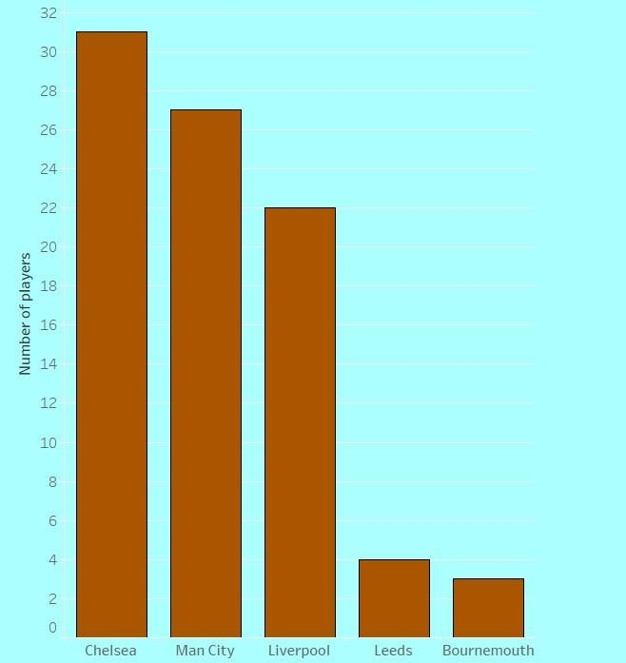
Number of players leaving a club
Chelsea has the highest release of players whereas Bournemouth has the least release of players.

Slide 9
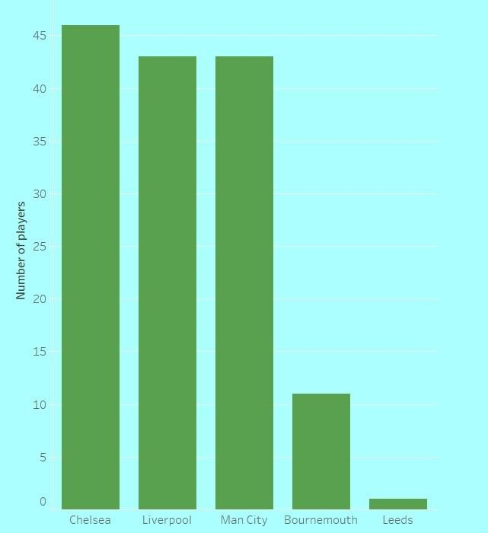
Intake of players by a club
Similarly, Chelsea also spends a significant amount on purchasing players. The club is known for its aggressive strategy in the transfer market, often making high-profile signings to strengthen the squad. This approach reflects their commitment to remaining competitive at the highest levels of football.

Slide 10
CONCLUSION
Premier League has the highest market and transfer values among the 5 leagues. (Reference: sun news link)
The Center Forward position has the highest market and transfer values among all the remaining positions.
Chelsea has the greatest transfer value among Premier League clubs.This could be because of the huge budget allotted by Chelsea management.
Also, Chelsea has the maximum number of players leaving and the maximum intake of players.This could be because of the competitiveness among Chelsea clubs to maintain top-class players.

